Slide 1
Amazon Web Services
Velocity Training Institute
Shantanu Mahajan – (sr engg devops)

Slide 2
AWS – Infrastructure as a service
AWS is a cloud service where we are creating our infrastructure.
Here instead of local DC infra we are using AWS
Main Features
a. Infra Maintenance is not on our side.
b. H/W related upgrade or downgrade Is not on our side.
c. Pay as you go. Service provided on rental basis.
d. Only pay for the time you use. (Per Hour billing format)
e. On Demand, Flexible, Scalable etc.

Slide 3
Features
Elastic Capacity
Scaling Up and Down in mins
No need to provision
Optimization of resources such as CPU/RAM etc. is possible.
Can manage unexpected peaks
Quick and Easy Deployments.
IT infra is no longer a barrier
Easier to test software on different solutions
No need to wait for provisioning

Slide 4
Features
No initial investment needed
Automation and reusable components-
a. Creation of application templates, instances storages etc. is possible.

Slide 5
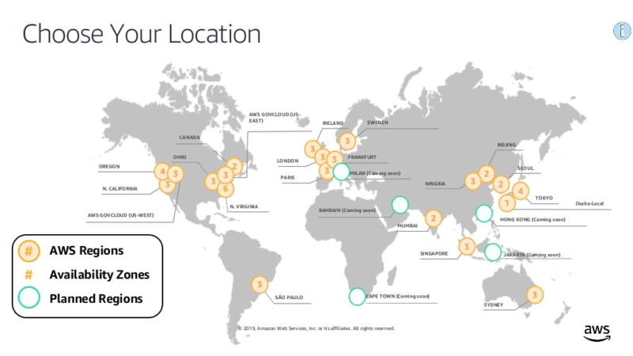
Global AWS Infra

Slide 6
Global AWS infra
Every DC location is called as a region
Every region has multiple zones
AWS breaks down a region into multiple zones
Every zone is independent of each other.
Each zone is represented alphabetically like a,b,c ….etc.
The AWS Cloud spans 84 Availability Zones within 26 geographic regions around the world, with announced plans for 24 more Availability Zones and 8 more AWS Regions in Australia, Canada, India, Israel, New Zealand, Spain, Switzerland, and United Arab Emirates (UAE).

Slide 7
Availability regions and zones
AWS has the concept of a Region, which is a physical location around the world where we cluster data centers.
We call each group of logical data centers an Availability Zone.
Each AWS Region consists of multiple, isolated, and physically separate AZs within a geographic area.
Unlike other cloud providers, who often define a region as a single data center, the multiple AZ design of every AWS Region offers advantages for customers. Each AZ has independent power, cooling, and physical security and is connected via redundant, ultra-low-latency networks.
AWS customers focused on high availability can design their applications to run in multiple AZs to achieve even greater fault-tolerance.
AWS infrastructure Regions meet the highest levels of security, compliance, and data protection.

Slide 8
Availability zones
An Availability Zone (AZ) is one or more discrete data centers with redundant power, networking, and connectivity in an AWS Region.
AZs give customers the ability to operate production applications and databases that are more highly available, fault tolerant, and scalable than would be possible from a single data center.
All AZs in an AWS Region are interconnected with high-bandwidth, low-latency networking, over fully redundant, dedicated metro fiber providing high-throughput, low-latency networking between AZs.
All traffic between AZs is encrypted.
The network performance is sufficient to accomplish synchronous replication between AZs. AZs make partitioning applications for high availability easy.
If an application is partitioned across AZs, companies are better isolated and protected from issues such as power outages, lightning strikes, tornadoes, earthquakes, and more.
AZs are physically separated by a meaningful distance, many kilometers, from any other AZ, although all are within 100 km (60 miles) of each other.

Slide 9
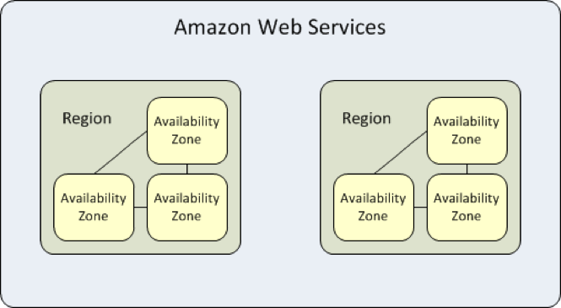
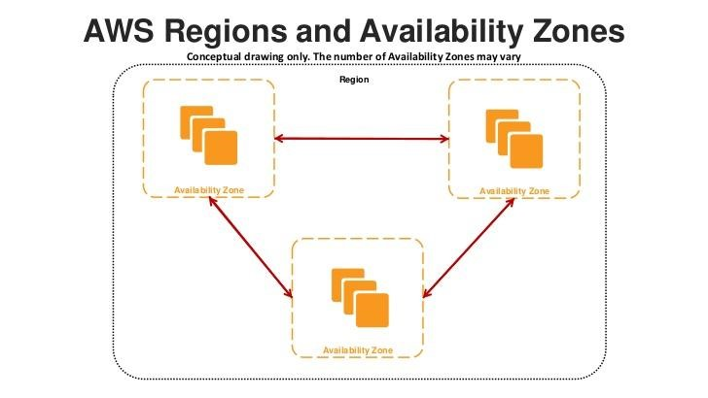

Slide 10
The aws universe
Management + Interface
Cross Service Features
Platform Building Blocks
Infrastructure Building Blocks

